Slide 1

INFINITY
CODERS
By Akshay Jha
Roll:- 2110990127, G5, CSE 3rd Year
Course Instructor:- Lavish Arora Sir

Slide 2
About the project
Some key features
Screenshots
Live Preview
Index

Slide 3

Introduction
Web-based course selling e-commerce platform built with HTML, CSS, and JavaScript
Category wise Courses
Includes login and sign-up capabilities
Student Dashboard
Features a shopping cart for easy product management
Incorporates Watch Video Feature

Slide 4
Features Of Infinity Coders
Interactive Ui
Styling
Student Dashboard
Cart functionality for users
Customizable global themes
Distinct style sheets for different styling
Unified design system with a single style sheet
Individual style sheets for specific pages, maintaining global design consistency
Scripting
Scripting for user interactions
Automatic redirection to sign-in for non-logged-in users
Video Filtering According to Difficulty

Slide 5



Technology Stack
HTML 5
JavaScript
CSS / CSS3

Slide 6

Home

Slide 7

About Us

Slide 8
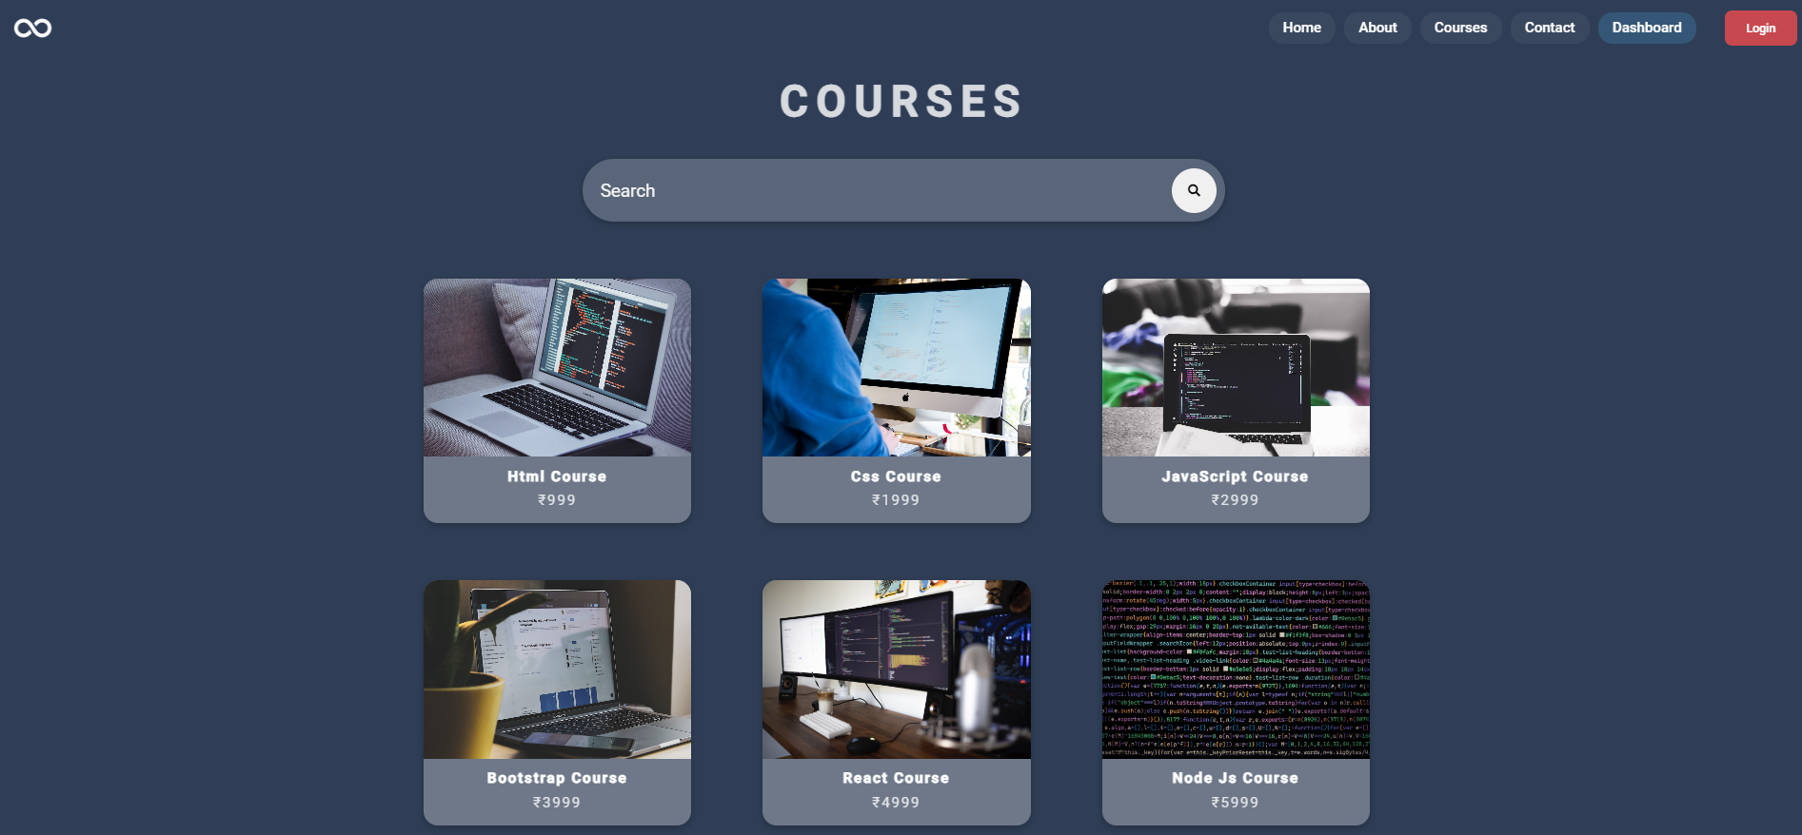
Courses

Slide 9
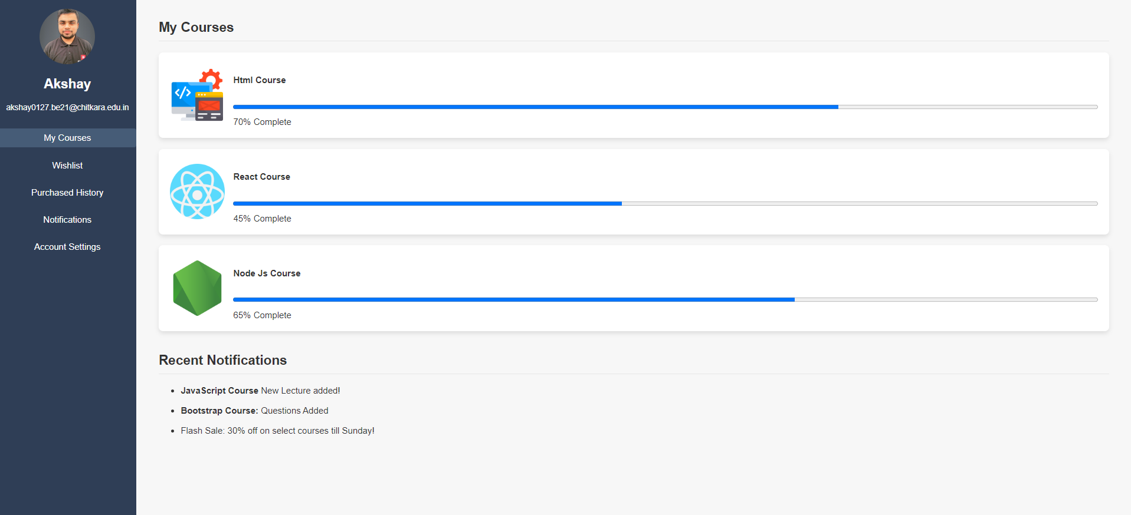
Dashboard

Slide 10

Course Gallery

Slide 11
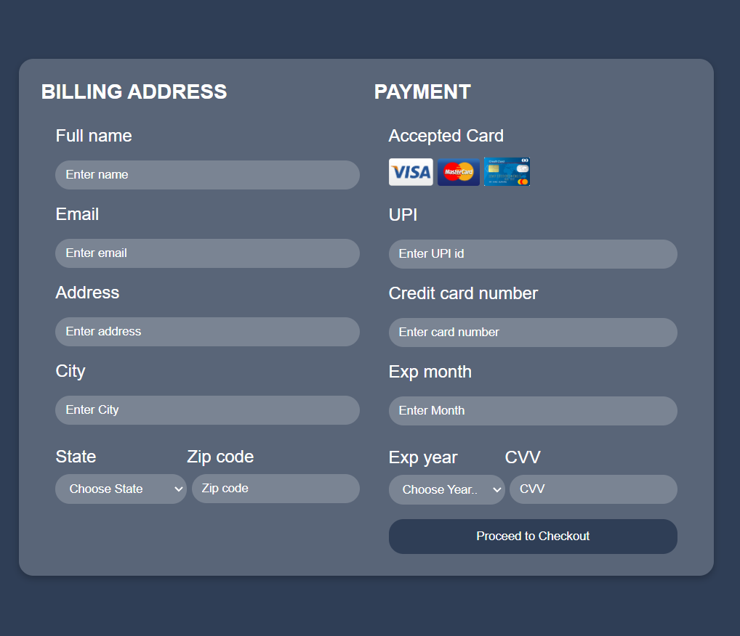
Checkout

Slide 12
Live Preview
https://infinity-coders.vercel.app

Slide 13
Thank You

